Slide 1


Vincent
August 2024

Slide 2
Executive Summary
Introduction
Methodology
Results
Conclusion
Appendix
Outline

Slide 3
Executive Summary
Main steps for this analysis:
Data collection with API and web scrapping
Data wrangling and cleaning
Exploratory data analysis with SQL and visualization
Map creation with folium
Interactive dashboarding with dash
Training of machine learning models dans hyperparameter optimization.
Summary of all results
With the data collected, features can be extracted to train machine learning models and predict a launch outcome based on the history of launches.
A tree model reaches almost 95% accuracy

Slide 4

Introduction
Project background and context
Space X advertises Falcon 9 rocket launches on its website with a cost of 62 million dollars; other providers cost upward of 165 million dollars each, much of the savings is because Space X can reuse the first stage. Therefore if we can determine if the first stage will land, we can determine the cost of a launch. This information can be used if an alternate company wants to bid against space X for a rocket launch.
Problems you want to find answers
Perform exploratory Data Analysis and determine useful features
Evaluate the capacity to train an accurately predict a launch outcome based on selected features and recent history of lanches
Use this knowledge to determine the best launch site for a mission

Slide 5

Section 1

Slide 6
Methodology
Executive Summary
Data collection methodology:
Data was collected from the API provided by SpaceX
Additional data was obtained through web scrapping on Wikipedia
Perform data wrangling
Data was cleaned, missing values imputed and categorical features one-hot encoded
Perform exploratory data analysis (EDA) using visualization and SQL
Perform interactive visual analytics using Folium and Plotly Dash
Perform predictive analysis using classification models
Various models were trained, hyperparameters selected with Grid search and final accuracies compared.

Slide 7
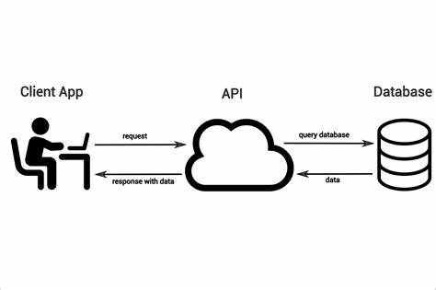
Data Collection – SpaceX API
Data was queried from the API provided by Spacex with the requests library.
Data was then cleaned, filtered and missing values were handled
Additional was retrieved by scrapping tables from Wikipedia

Slide 8
Data Collection – SpaceX API
We used several endpoints from the SpaceX API to extract useful data:
https://api.spacexdata.com/v4/rockets/
https://api.spacexdata.com/v4/launchpads/
https://api.spacexdata.com/v4/payloads/
https://api.spacexdata.com/v4/cores/
The ScaceX API Notebook is available here: IBMDataScience/jupyter-labs-spacex-data-collection-api.ipynb at main · VincentC75/IBMDataScience (github.com)

Slide 9
Data Collection - Scraping
We used the beautiful soup library to scrape data from tables in Wikipedia pages.
The web scraping notebook is available here: https://github.com/VincentC75/IBMDataScience/blob/main/jupyter-labs-webscraping.ipynb

Slide 10

Data Wrangling
During data wrangling, we:
Calculatied the number of launches on each site
Calculated the number and occurrence of each orbit
Calculated the number and occurence of mission outcome of the orbits
Created a landing outcome label to be used as the dependent variable for machine learning
The data wrangling notebook is available here: IBMDataScience/labs-jupyter-spacex-Data wrangling.ipynb at main · VincentC75/IBMDataScience (github.com)

Slide 11
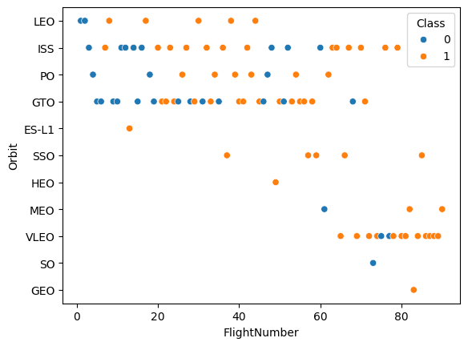
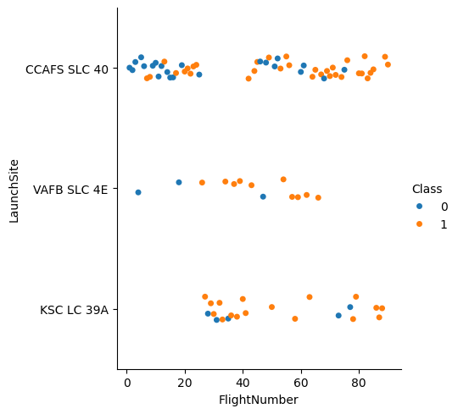
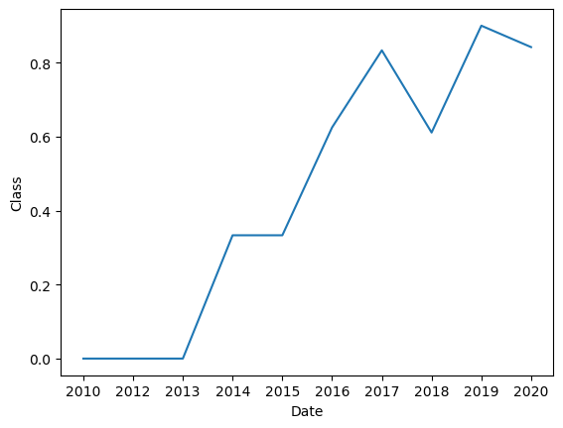
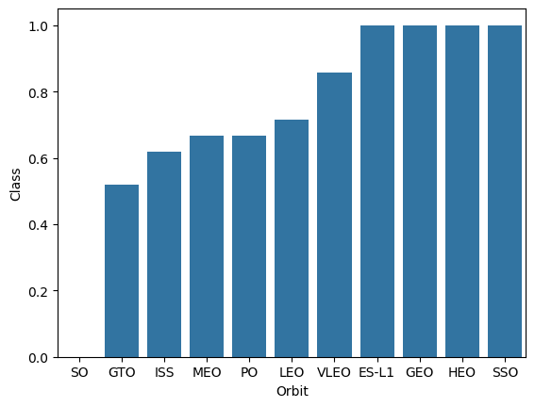
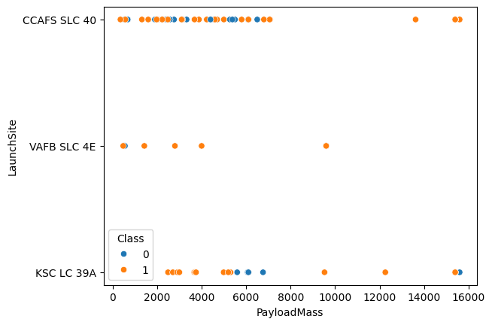
EDA with Data Visualization
We used scatter plots, bar plots and lines charts to visualize the SpaceX data
The EDA with data visualization notebook is available here: IBMDataScience/edadataviz.ipynb at main · VincentC75/IBMDataScience (github.com)

Slide 12

EDA with SQL
We used SQL queries to:
Show DISTINCT values
Filter on partial strings with LIKE
Filter data on value with WHERE and on range with BETWEEN
Group and summarize data with GROUP BY, SUM and AVG
Filter on the result of a subquery
Use multiple filters to answer complex questions
The completed EDA with SQL notebook is available here: IBMDataScience/jupyter-labs-eda-sql-coursera_sqllite.ipynb at main · VincentC75/IBMDataScience (github.com)

Slide 13

Build an Interactive Map with Folium
On top of the US map, we added;
Circles to show the launch sites
Cluster of markers to indicate the launch outcomes
Lines to indicate the distance to coastline or the closest city
Text with calculated distance
The interactive map with Folium notebook is available here: IBMDataScience/lab_jupyter_launch_site_location.ipynb at main · VincentC75/IBMDataScience (github.com)

Slide 14
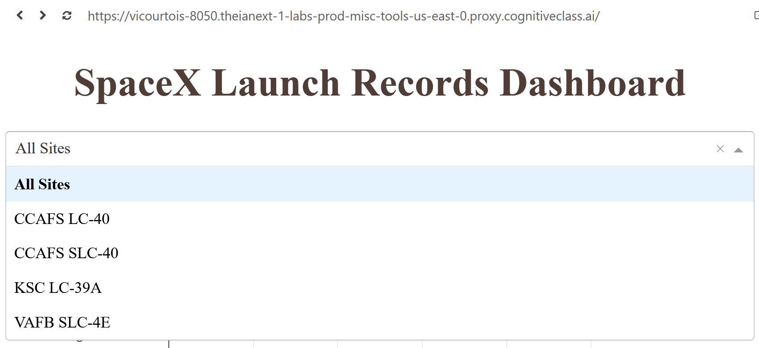
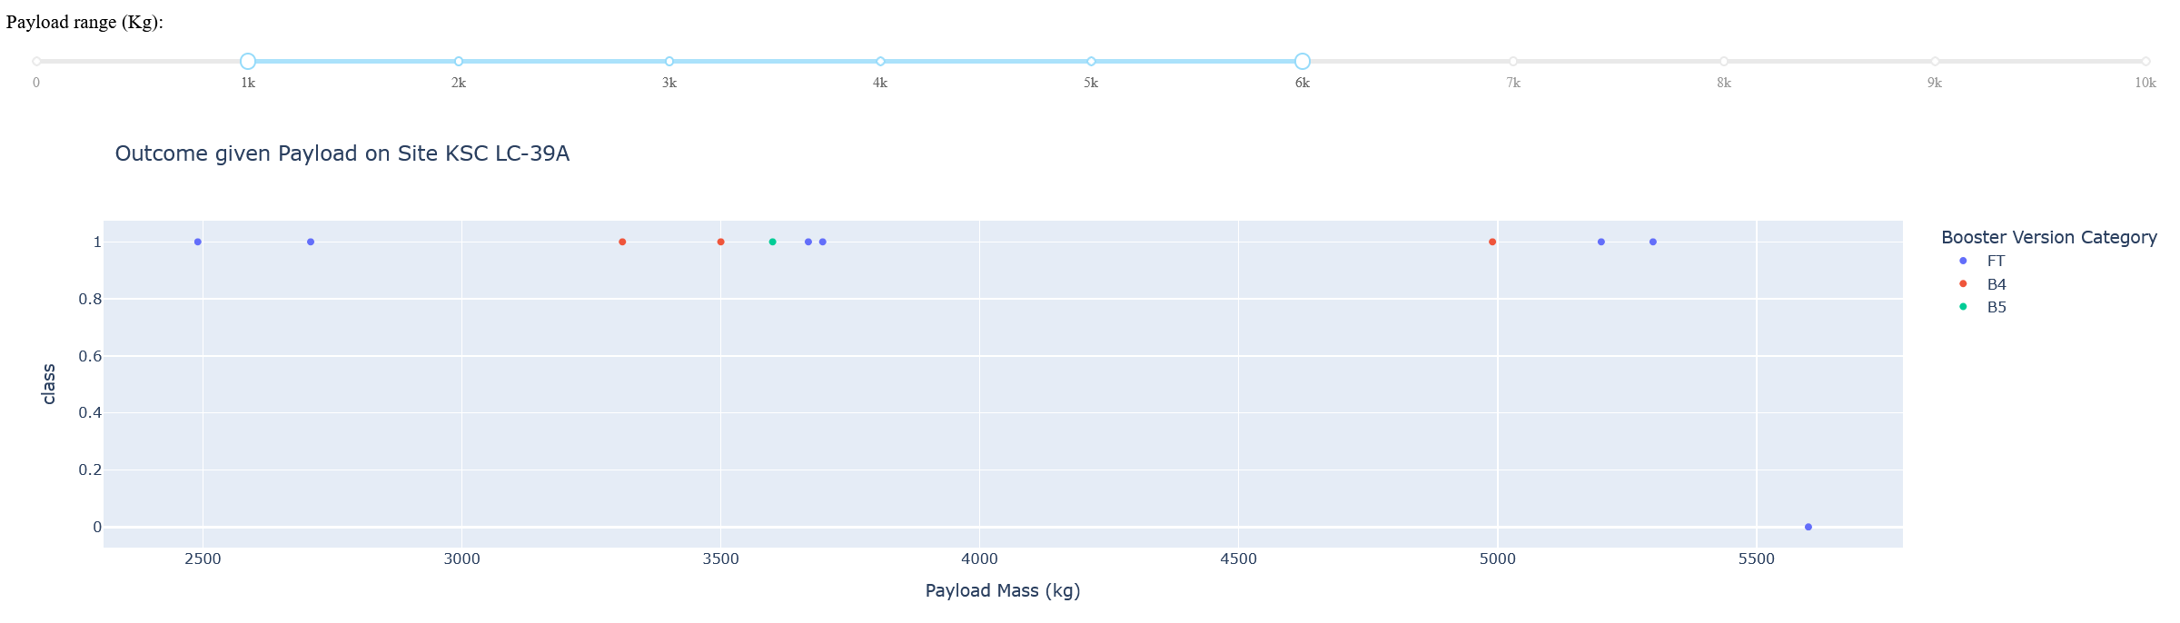
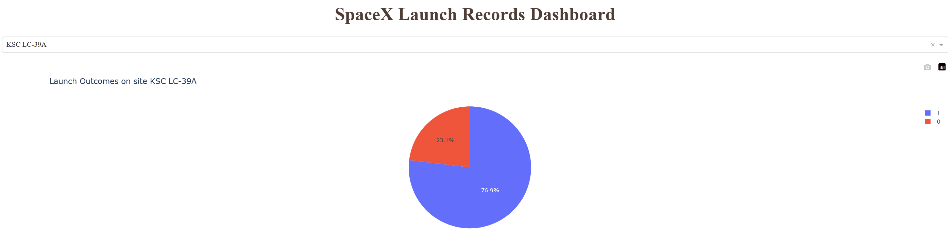
Build a Dashboard with Plotly Dash
In the Dash interactive dashboard we used:
A dropdown box to select the site
A slider to select the payload
A Pie Chart
A scatterplot
The Python code for the Dash lab is available here: IBMDataScience/spacex_dash_app.py at main · VincentC75/IBMDataScience (github.com)

Slide 15
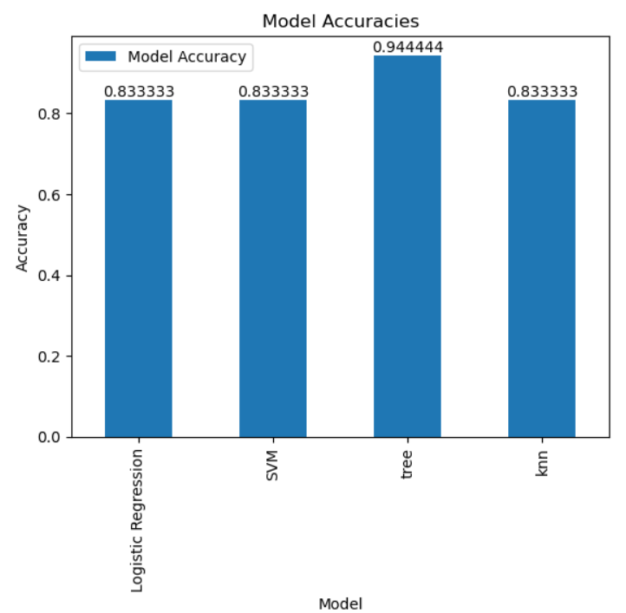
Predictive Analysis (Classification)
The previous steps lefts use with a dataset with preselected features and the outcome dependent variables.
We trained several types of classification models and used grid search to optimize the hyperparameters
We computed and compared the accuracies on test data to select the best model.
The machine learning notebook is available here: IBMDataScience/SpaceX_Machine Learning Prediction_Part_5.ipynb at main · VincentC75/IBMDataScience (github.com)

Slide 16
Results
Exploratory data analysis allowed use to better understand our data and select the useful features for model building
Interactive analytics dashboard was useful to further explore our data in an interactive and visual way
Predictive analysis showed that a tree model allowed to predict with almost 95% accuracy the outcome of a launch.

Slide 17

Section 2

Slide 18
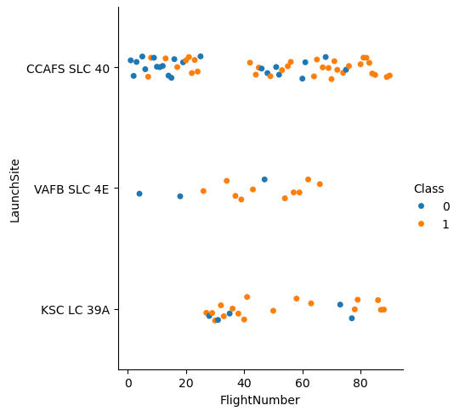
Flight Number vs. Launch Site
This scatter plot show the Flight Number vs. Launch Site
The outcome (failure in blue, success in orange) is color coded. It show that as flight number increases there are more successes.

Slide 19
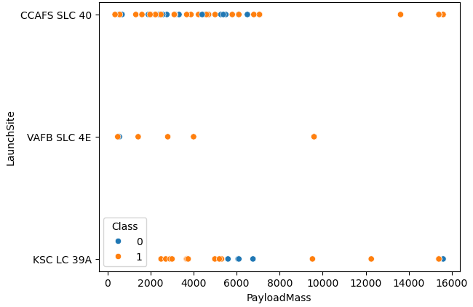
Payload vs. Launch Site
This scatterplot shows that the VAFB SLC 4E site is dedicated to smaller payloads and has much less launches.

Slide 20
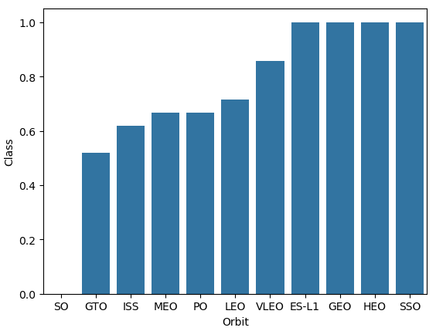
Success Rate vs. Orbit Type
Show a bar chart for the success rate of each orbit type
Show the screenshot of the scatter plot with explanations

Slide 21
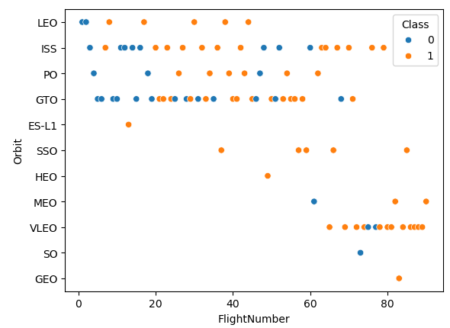
Flight Number vs. Orbit Type
Show a scatter point of Flight number vs. Orbit type
Show the screenshot of the scatter plot with explanations

Slide 22
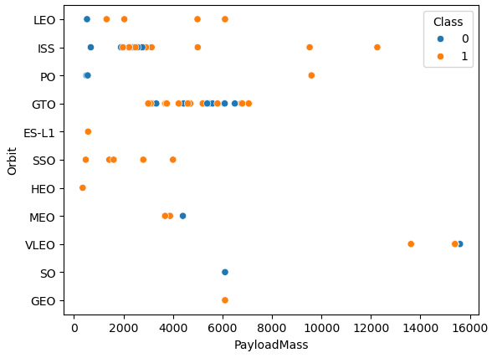
Payload vs. Orbit Type
Show a scatter point of payload vs. orbit type
Show the screenshot of the scatter plot with explanations

Slide 23
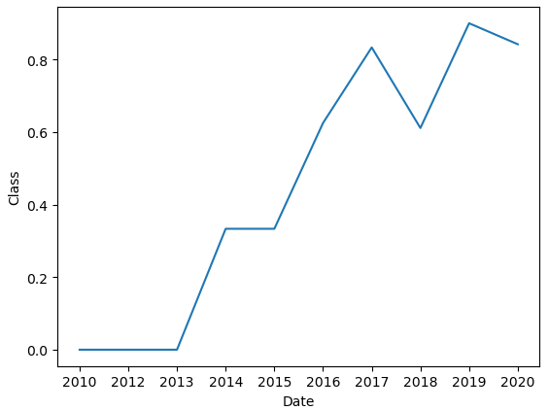
Launch Success Yearly Trend
Show a line chart of yearly average success rate
Show the screenshot of the scatter plot with explanations

Slide 24
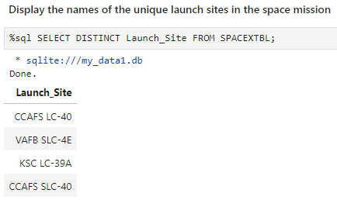
All Launch Site Names
To find the names of the unique launch sites we include the DISTINCT keyword to eliminate duplicates in the result.

Slide 25
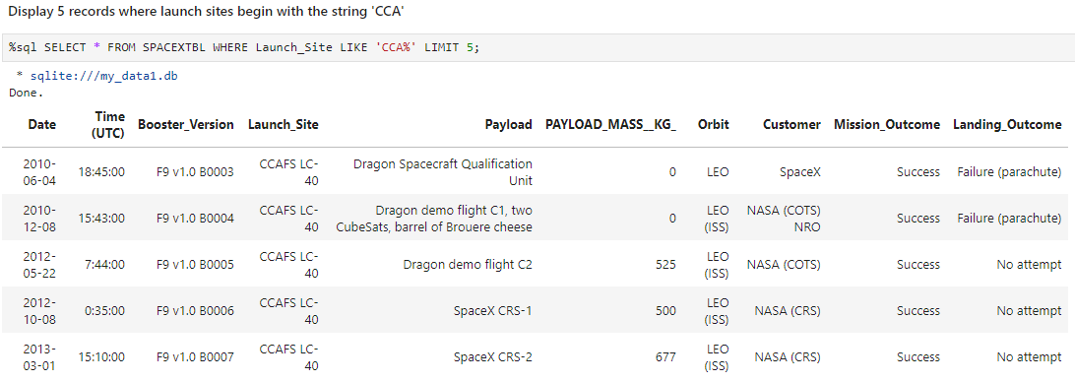
Launch Site Names Begin with 'CCA'
This query requires the use of the LIKE command to filter the launch site by name and the LIMIT clause to choose the number of results to display.

Slide 26
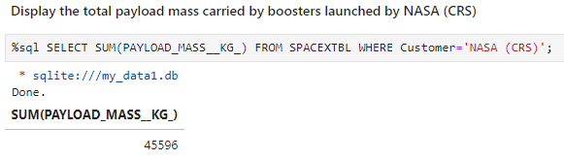
Total Payload Mass
The total payload carried by boosters from NASA is calculated with the SUM aggregation command. The customer is filtered in the WHERE clause.

Slide 27
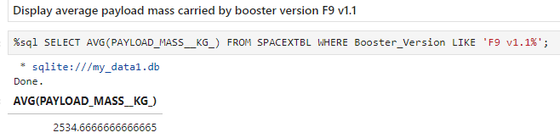
Average Payload Mass by F9 v1.1
The average payload mass carried by booster version F9 v1.1is calculated by using the AVG function and filtering the Booster version with a LIKE clause.

Slide 28
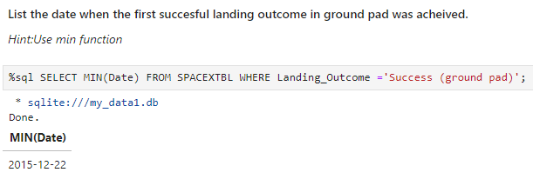
First Successful Ground Landing Date
The date of the first successful landing outcome on ground pad is found by first filtering the relevant outcomes and applying the MIN function to select the earliest date.

Slide 29
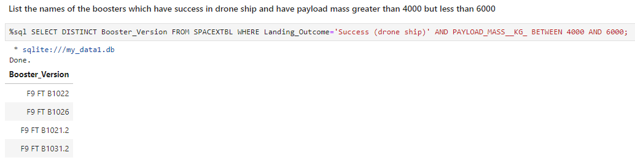
Successful Drone Ship Landing with Payload between 4000 and 6000
We use the DISTINCT clause to eliminate duplicates and filter on the Landing Outcome and Payload Mass in the WHERE clause. The BETWEEN clause allows to select the payload between 4000 and 6000.

Slide 30
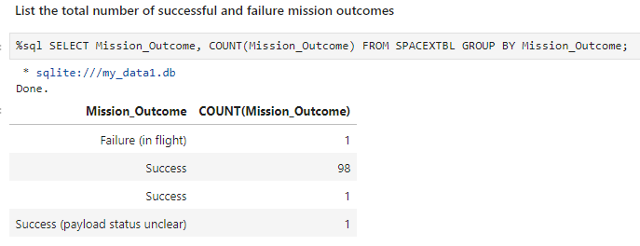
Total Number of Successful and Failure Mission Outcomes
We use the GROUP BY clause to group the count by Mission Outcome
We could also modify the query to group together the three outcomes which are successes by have a different values in the Mission_Outcome column.

Slide 31
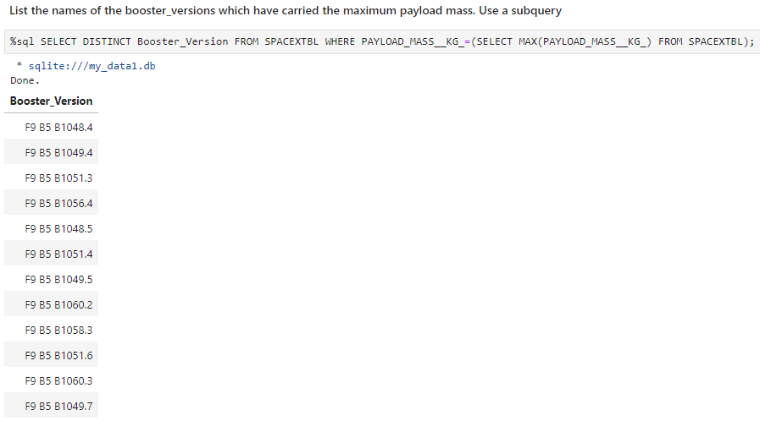
Boosters Carried Maximum Payload
Here we use a subquery to find the maximum payload. The result is then reused in the WHERE clause.

Slide 32
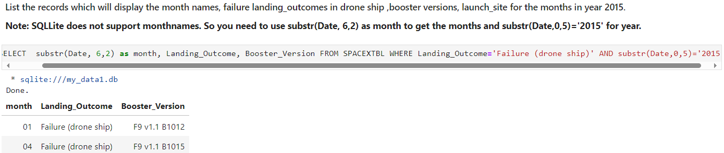
2015 Launch Records
The SUBSTR function is used to extract the month and the year from the Date filed.

Slide 33
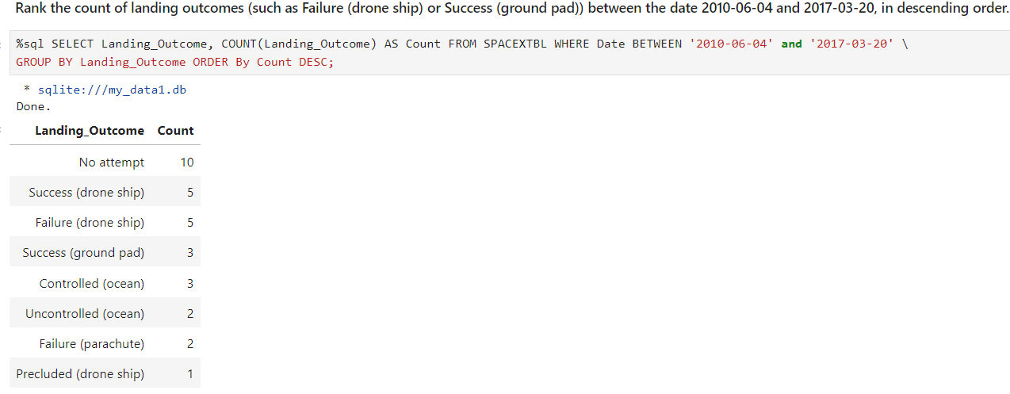
Rank Landing Outcomes Between 2010-06-04 and 2017-03-20
This query has a filter on a date range and is grouped by Landing Outcome.
The DESC clause reverses the order to get the greatest count on top.

Slide 34

Section 3

Slide 35
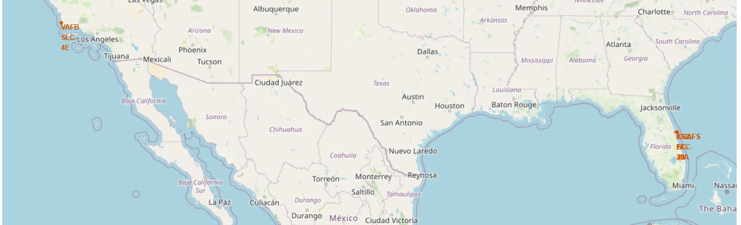
SpaceX Launch Sites Location
SpaceX launch sites are located in the south of the United States to be close to the equator.
There is a launch site on the west coast in California and two launch sites on the west coast in Florida.

Slide 36
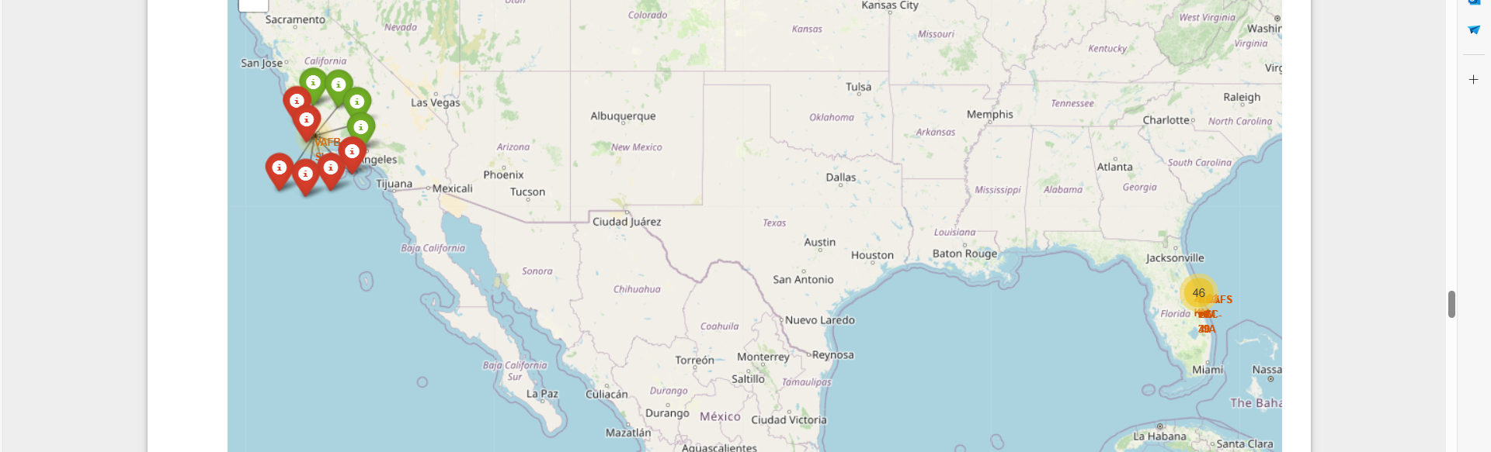
Color-labeled Launch Outocomes
Color-coded markers show the outcomes when zooming on a given site.

Slide 37
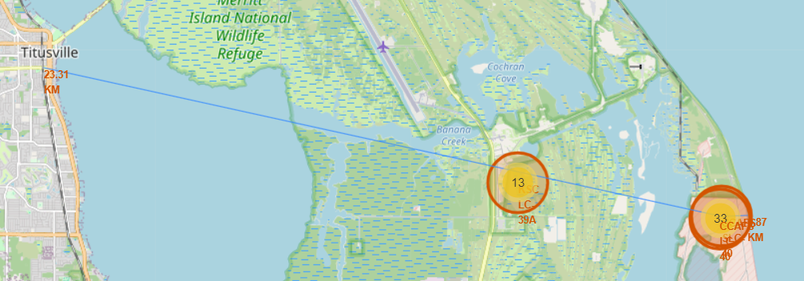
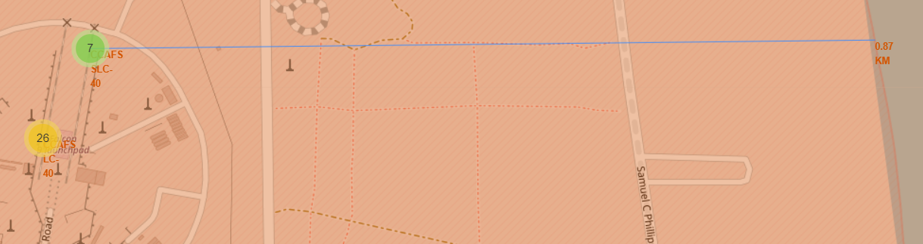
Proximity to coastline and city
An indicator can be shown on the map to underline the distance to the coast or to the closest city.

Slide 38

Section 4

Slide 39
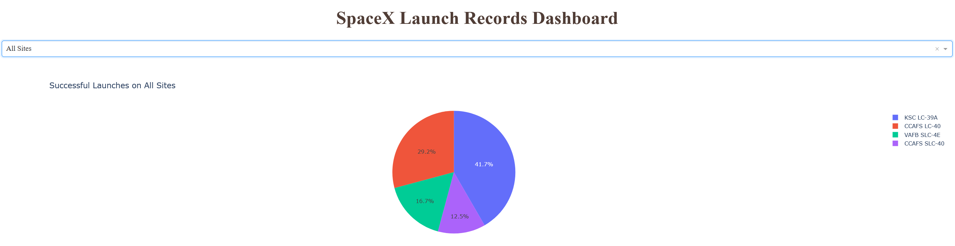
Pie Chart of launch success count for all sites
A pie chart allows to show how each site contributed to successful launches.

Slide 40
Launch Outcomes on site KSC-LC-39A
The dashboard allows to zoom on a given site and show the proportion of successes on this site.

Slide 41
Scatterplot of Outcome given Payload on site KSC-LC-39A
The dashboard contains a slider to select the payload and a combo box for the site.

Slide 42

Section 5

Slide 43
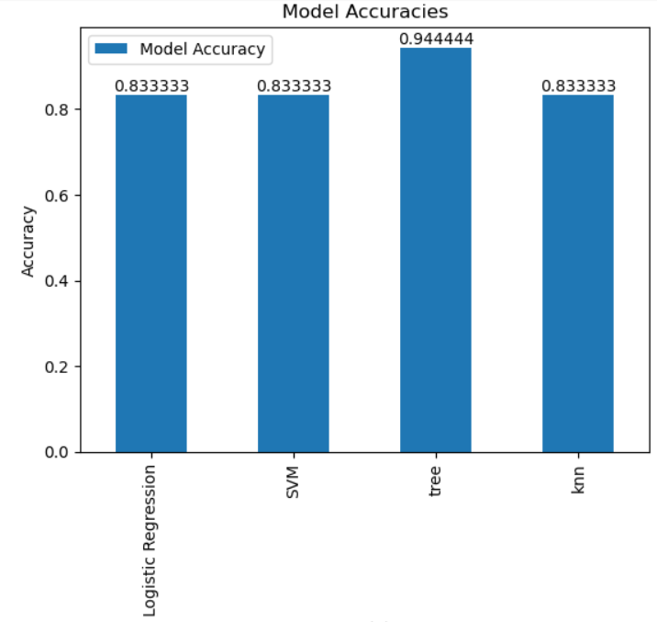
Classification Accuracy
The Tree classifier has the best accuracy of all models.

Slide 44
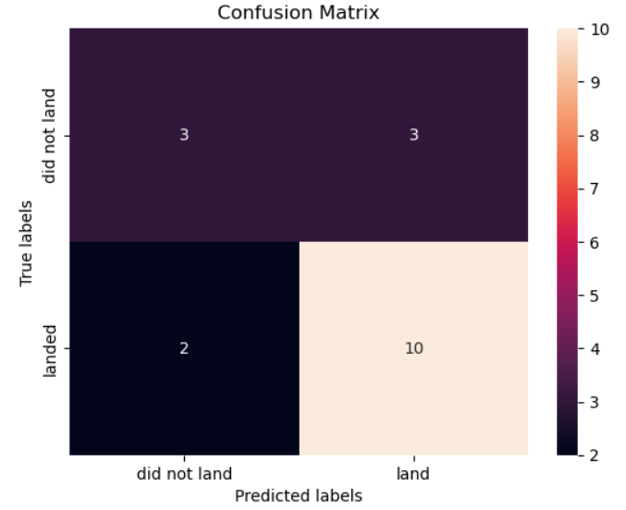
Confusion Matrix
The tree classifier makes only 5 errors, with 2 false positives and 3 false negatives.

Slide 45
Conclusions
This project shows that the success of SpaceX launches can be predicted with a reasonable accuracy when models are trained on chosen features.
With time the proportion of successes increases so we could put a bigger weight on recent data to improve our predictions
We could also combine our different models. They may not do the same mistakes and the combined model performs usually better.

Slide 46
Appendix
All notebooks, source code and helper files are available in my Github repository for this project:
VincentC75/IBMDataScience: IBM Data Science on Coursera (github.com)

Slide 47


